Slide 1
Multiprocessing using OpenMP
Shared Variables and Cache Coherency

Slide 2
Shared vs Private Variables
Cache Coherency

Slide 3
Private and Shared Variables
Shared Variables
A shared variable is accessible by all threads in the team.
The initial value of a shared variable is set before the parallel region begins, and all threads can modify this variable during execution.
Be careful when accessing shared variables in parallel regions, as race conditions may occur if multiple threads try to modify them simultaneously.
Private Variables
A private variable is unique to each thread.
Each thread has its own copy of the private variable, and the value is undefined at the beginning of the parallel region unless initialized.
Modifying a private variable does not affect other threads.

Slide 4
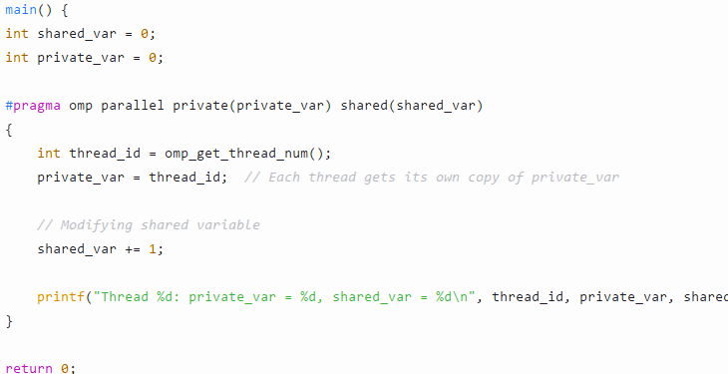
Private and Shared Variables

Slide 5
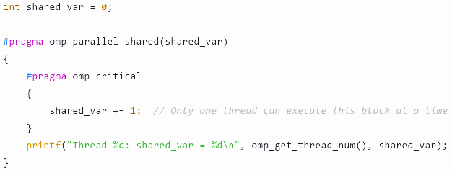
Protection Techniques in OpenMP
Critical Section
A critical section ensures that only one thread can access a certain section of code at a time.
This is typically used to protect shared variables from concurrent access.

Slide 6
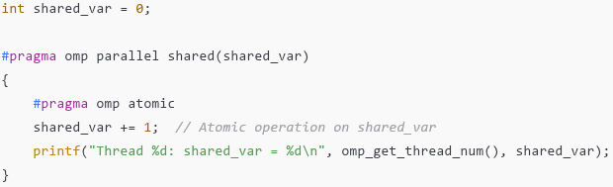
Protection Techniques in OpenMP
Atomic Operation
Atomic operations allow certain operations (e.g., addition or subtraction) to be performed atomically, ensuring no race conditions without locking.

Slide 7
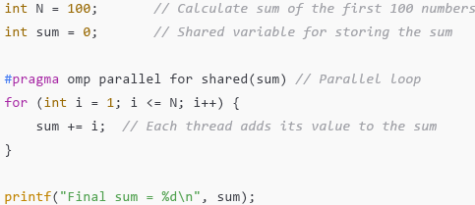
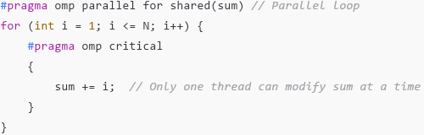
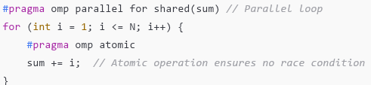
Example : Sum of N Numbers

Slide 8
Cache Coherency in Multi-Processor Systems
When threads are scheduled on multiple processors (cores), cache coherency becomes an issue. Here’s why:
Cache Coherency Problem: Each core may have its own local cache, and threads running on different cores may access the same memory location. If one thread updates a value in its local cache, the other threads may not immediately see the updated value, leading to inconsistency.
Solution: Modern systems use cache coherence protocols (e.g., MESI protocol: Modified, Exclusive, Shared, Invalid) to ensure that the memory is consistent across all caches. OpenMP relies on the underlying hardware and its memory consistency model to manage cache coherency.

Slide 9
Cache Coherency in Multi-Processor Systems
Flush Operations: Some OpenMP implementations may automatically manage cache coherency by flushing the cache at appropriate points, ensuring that all threads observe consistent memory states. OpenMP does not directly manage the low-level details of cache coherency but assumes the underlying system handles this.

Slide 10
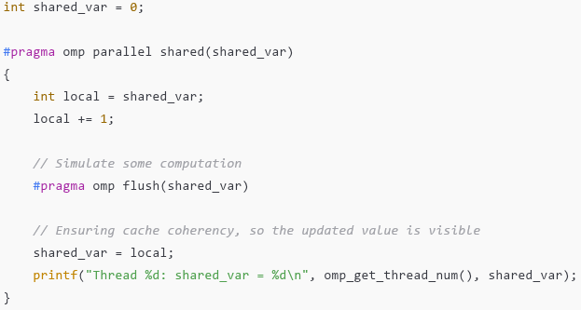
Cache Coherency in Multi-Processor Systems
The flush directive ensures that all memory operations on the shared variable are visible to all threads, helping with cache coherency.
When flush is used, it ensures that any updates to shared variables are properly synchronized across all threads and caches.

